Slide 1
Volcanic Eruption
Probability Analysis
If a volcano has erupted once, what is the probability it will erupt again?
Miles Tuman| CMSE 201| 003

Slide 2
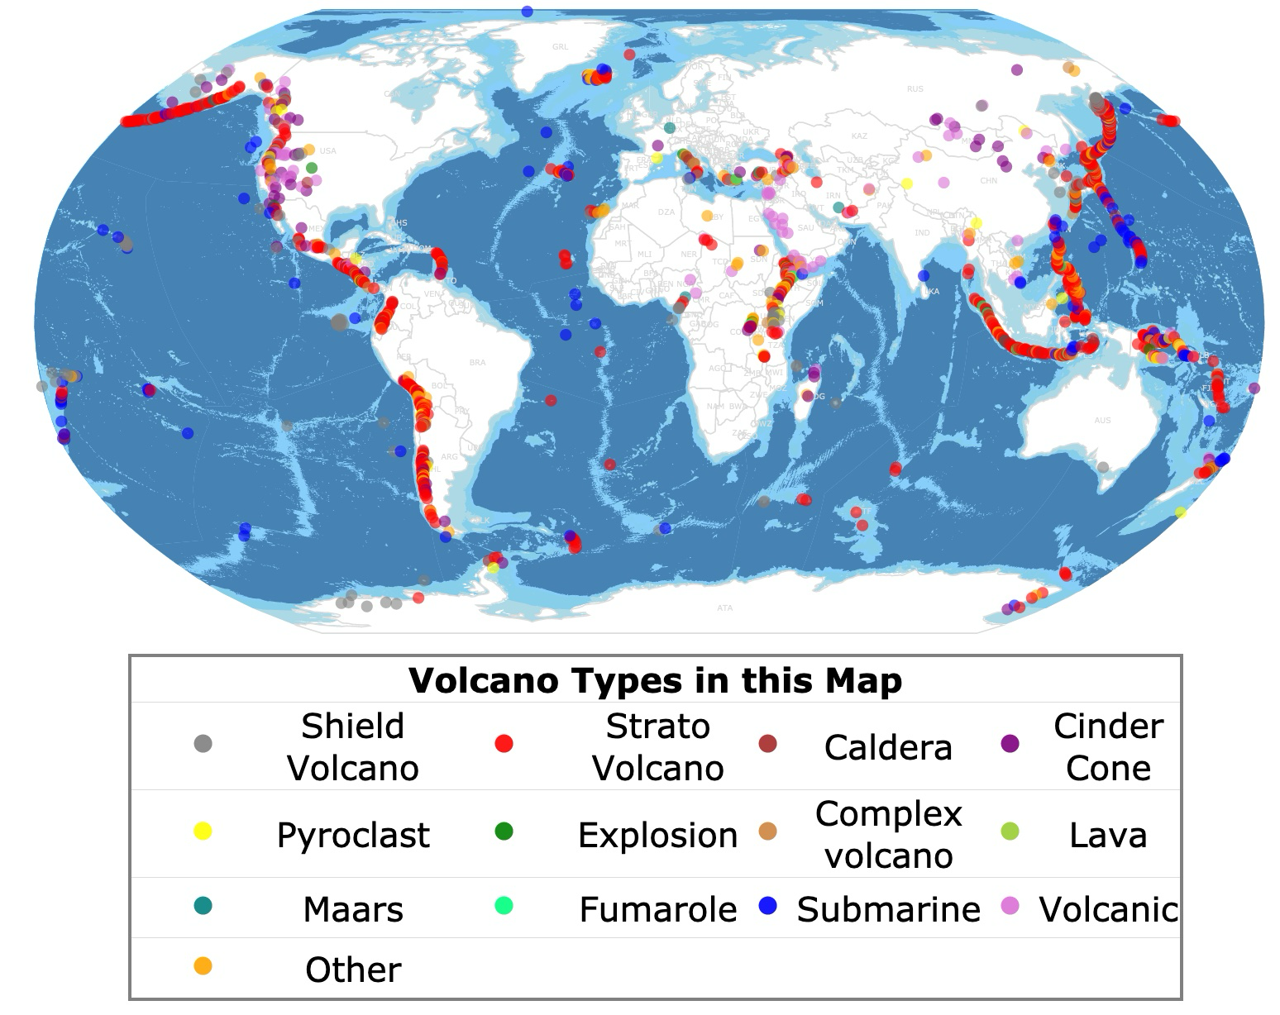
Background & Motivation
Research Question
If a volcano has erupted once, what is the probability it will erupt again?
Why It Matters
Understanding repeat eruption risk is critical for:
Disaster preparedness and evacuation planning
Identifying high-risk tectonic regions
[ Add volcano map or image here ]
“World Map of Volcano Types.” Map of Volcanoes Worldwide, databayou.com/volcano/map.html. Accessed 19 Apr. 2026.

Slide 3
Data Context
Source
Dataset
Key Variables
Kaggle dataset from Kanchana1990, with a useability of 10.0
898 eruption records across 20 volcano types and 10 tectonic regions with VEI ratings
Volcano type, tectonic region, VEI, eruption count, activity category, hazard score, Name and Country
⚠ Key Bias: Well-monitored regions (Japan, Ring of Fire) are overrepresented in the dataset while older volcanoes boost the average VEI, Underdeveloped countries are underrepresented in the dataset.

Slide 4
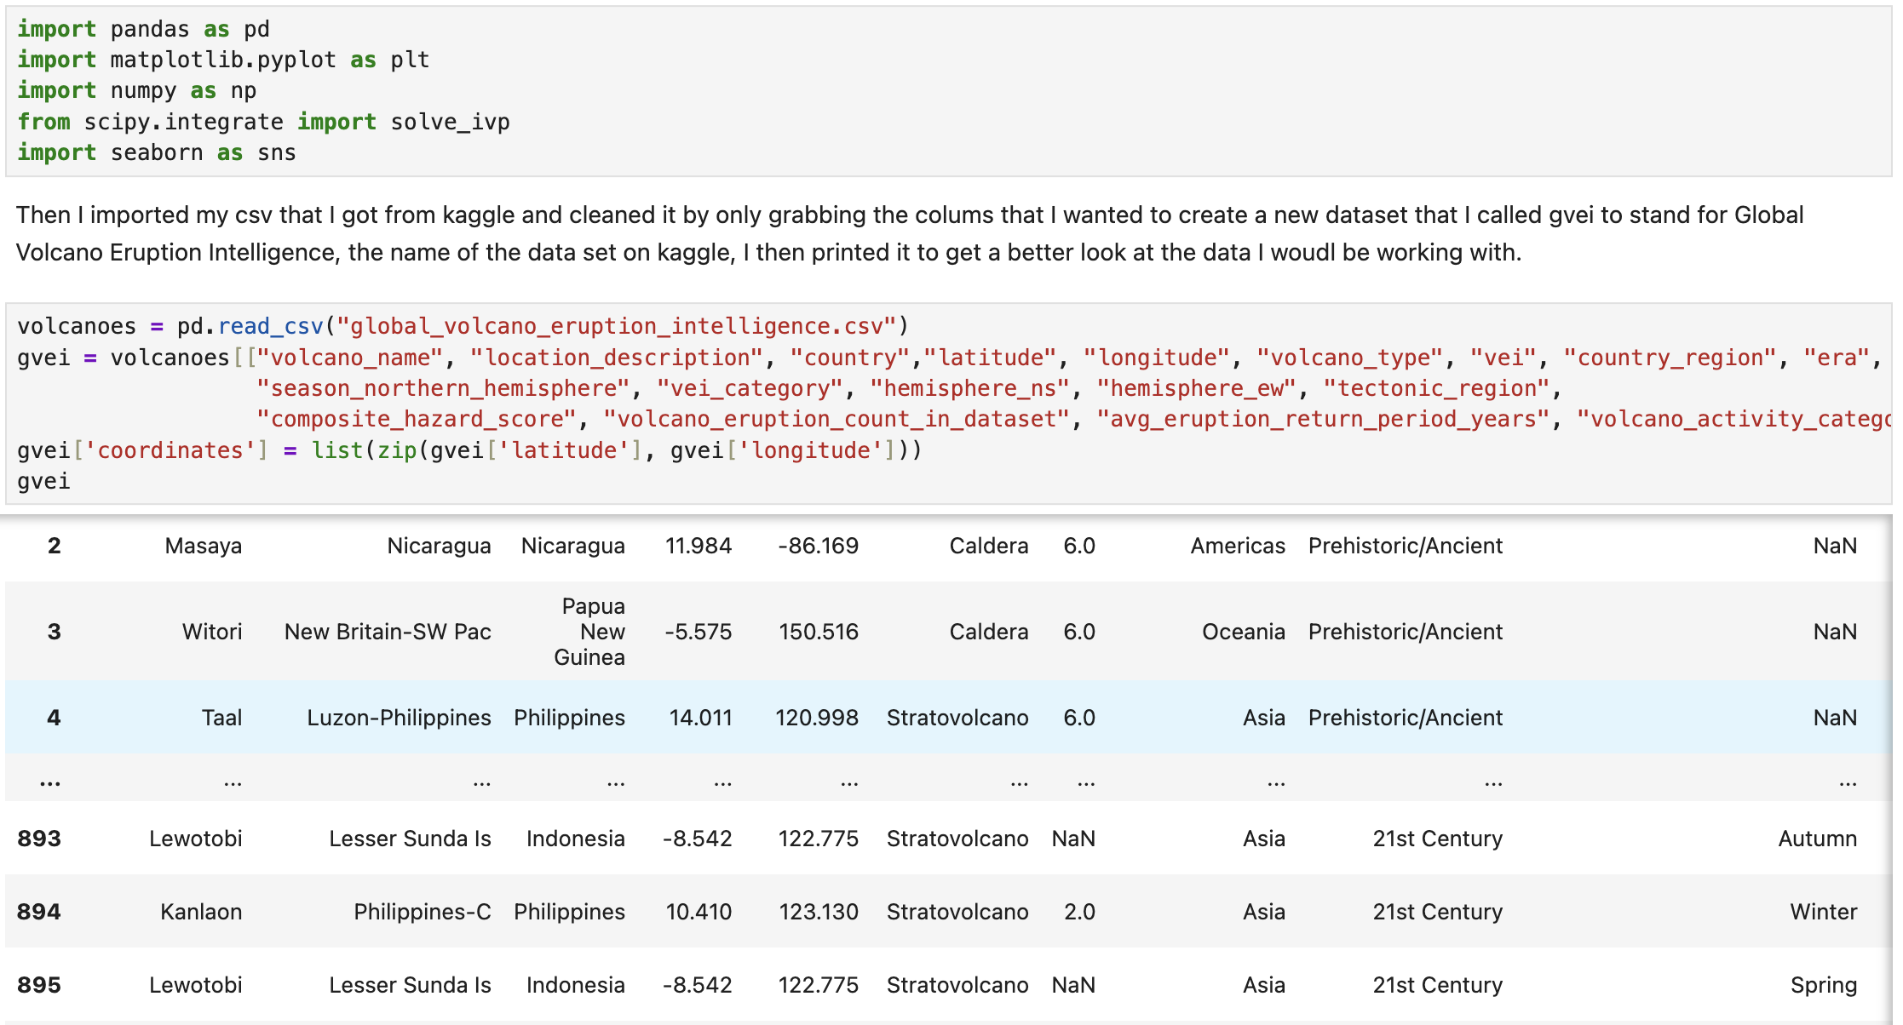
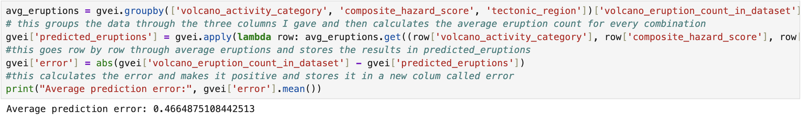
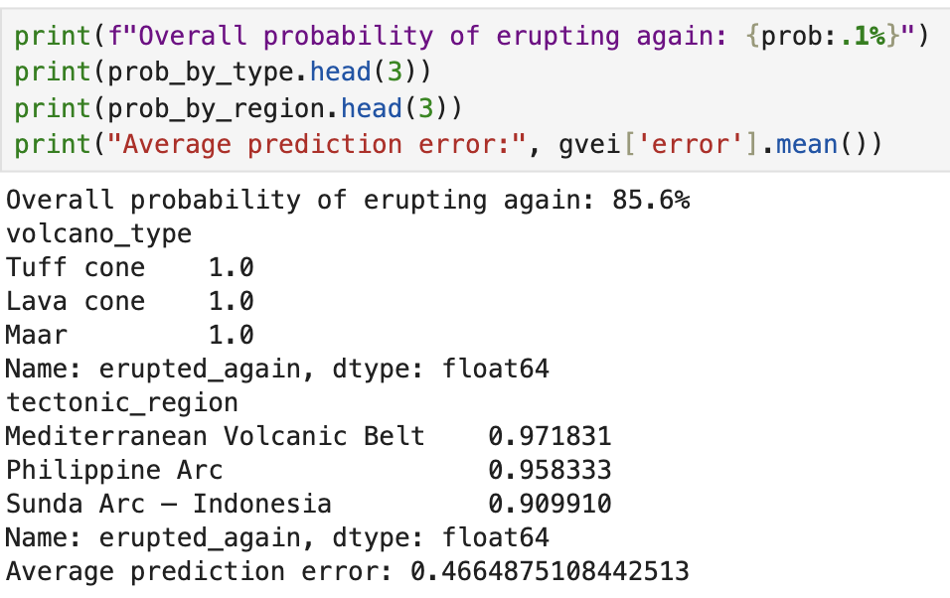
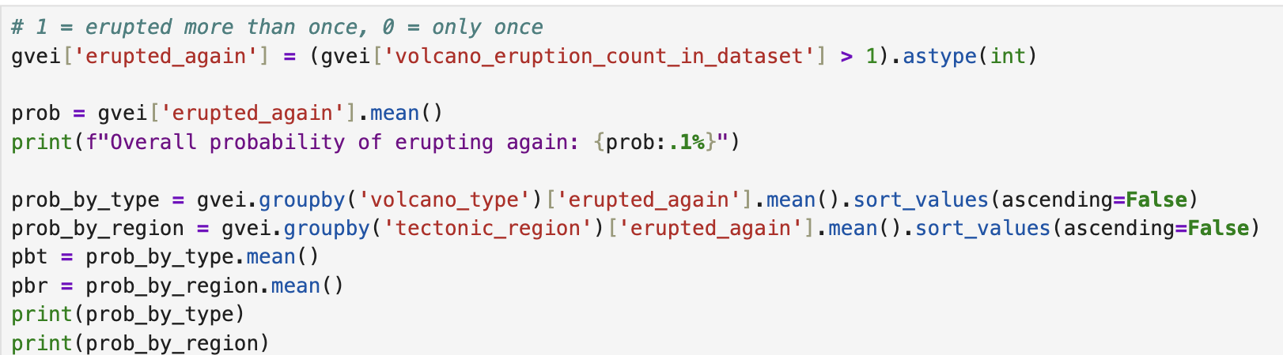
Methodology
1
Imported Libraries and Cleaned Data
Imported any Libraries I may want to use, also cleaned the dataset and created a new one called gvei
2
Predictive Model
Built grouped mean prediction model using volcano type, activity category, and tectonic region to get error of 0.47
3
Binary and Probability Calculation
Created a new column for gvei where 1 represents if the volcano erupted more then once and 0 if not, then calculated mean of binary variable grouped by volcano type and tectonic region
4
Model Evaluation
Model was based off probability by type or region. Measured accuracy using Mean Absolute Error

Slide 5
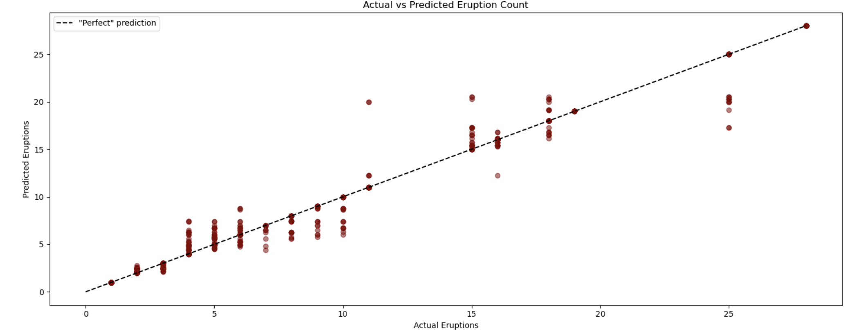

Slide 6
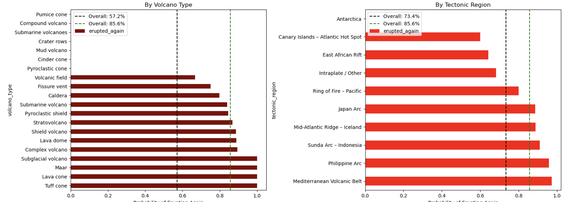
Results
Top Findings
Mediterranean Volcanic Belt: 97.2% probability → highest of all regions
  Philippine Arc: 95.8% | Sunda Arc – Indonesia: 90.9%
Tuff cone, Lava cone, Maar: 100% probability by volcano type
Prediction error dropped 92%: from 5.97 → 0.47 eruptions
85.6%
Overall probability
of erupting again

Slide 7
Discussion & Conclusion
Answer to Research Question
85.6% of volcanoes that erupt once will erupt again. Tectonic region significantly affects this, volcanoes in the Mediterranean Volcanic Belt are 11.6% more likely than average to erupt again.
Limitations
Reporting bias favors well-monitored regions
Rare volcano types (< 5 records) have unreliable probabilities
Model predicts count, not timing of eruptions
Lack of data from ancient times
What I Would Do Differently
Filter out volcano types with fewer than 5 records
Combine with ODE modeling to predict eruption rates per century
Find r^2

